Slide 1
Language-Integrated Query (LINQ)
Josh Reuben
Consultant, Sela Group
joshr@sela.co.il

Slide 2
Overview
extends query capabilities into the language syntax
Query any type of datastore in a standard manner: LINQ to SQL, XML, Datasets, Objects

Slide 3
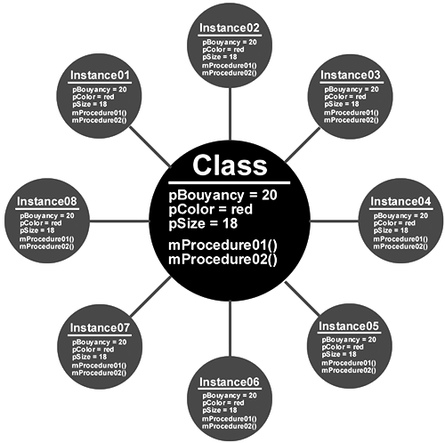
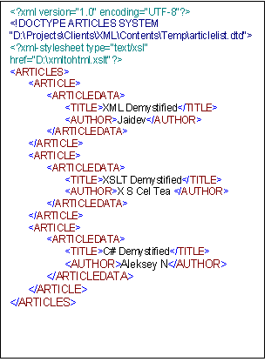
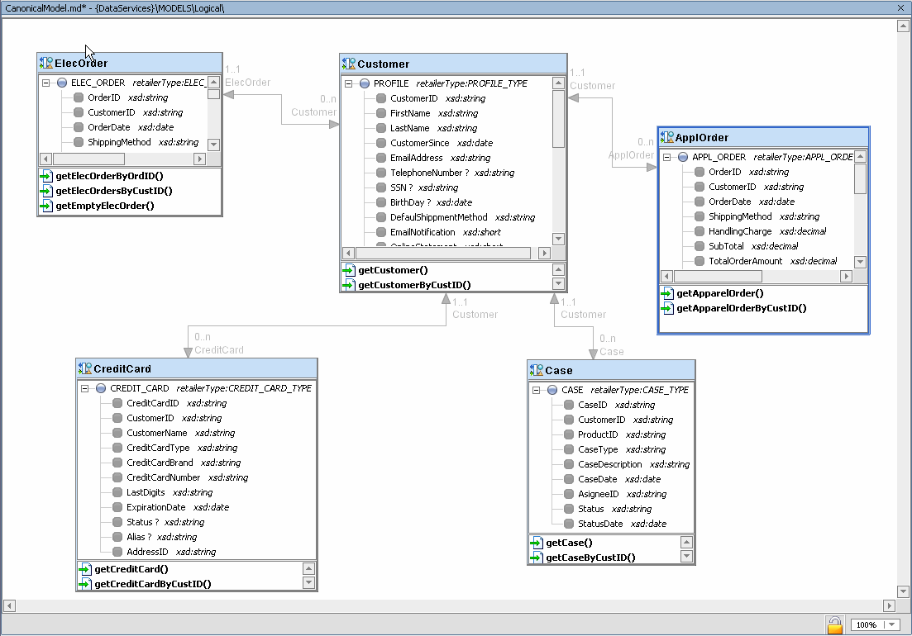
Bringing DataModels together
Relational
OO
XML

Slide 4
Advantages
Simplifies writing queries to a single language
Unifies syntax for querying back ends
Implicit typing – compile time checking
O/RM
Simplifies XML
Elegance & maintainability

Slide 5
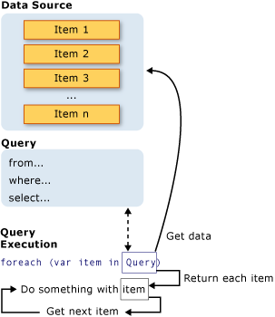
The Three Parts of a LINQ Query
Obtain the data source.
Create the query.
Execute the query.
Consistent

Slide 6
Demo 1 – a simple query

Slide 7
using System;
using System.Collections.Generic;
using System.Linq;
using System.Text;
namespace ConsoleApplication1
{
class Program
{
static void Main(string[] args)
{
// Data source.
int[] numbers = new int[7] { 0, 1, 2, 3, 4, 5, 6 };
// Query creation.
IEnumerable<int> numQuery =
from num in numbers
where (num % 2) == 0
select num;
// Query execution.
foreach (int j in numQuery)
{
Console.Write("{0,1} ", j);
}
}
}
}

Slide 8
Datasources
IEnumerable<T>
Create a data source from XML
// using System.Xml.Linq;
XElement contacts = XElement.Load(@"c:\myContactList.xml");
Create a data source from SQL
// using System.Data.Linq;
DataClasses1DataContext db = new DataClasses1DataContext();
Table<Customer> Customers = db.GetTable<Customer>();

Slide 9
Query Execution
Deferred – for vectors
foreach (int j in numQuery)
{
Console.Write("{0,1} ", j);
}
Immediate – for scalars
int query = (from num in numbers where (num % 2) == 0 select num).Count();
Forced Immediate – ToList<T> , ToArray<T>, var
List<int> query2 = (from num in numbers where (num % 2) == 0 select num).ToList();
// or
var query3 = (from num in numbers where (num % 2) == 0 select num).ToList();

Slide 10
New C# features
Anonymous types
var queryLondonNamesPhones3 =
from cust in Customers
select new { Name = cust.ContactName, Phone = cust.Phone };
Auto-implemented properties
public int ID { get; set; }
Initializers
Product oProduct = new Product { Name = "Cola", Category = "Beverages" };
Implicit typing (var)
var number = 5;
var name = "Virginia";

Slide 11
LINQ and Generics
LINQ queries are based on generic types
IEnumerable<T>
IEnumerable<Customer> queryCusts =
from cust in Customers
where cust.City == "London"
select cust;
foreach(Customer customer in queryCusts)
{
Console.WriteLine(customer.CompanyName + ", " + customer.ContactName);
}
Var – let the compiler infer the type:
var queryCusts2 =
from cust in Customers
where cust.City == "London"
select cust;
foreach(var customer in queryCusts2)
{
Console.WriteLine(customer.CompanyName + ", " + customer.ContactName);
}

Slide 12
Demo 2 – new C# features

Slide 13
Basic Query Operations
Generating – from
Filtering – where
Ordering – orderby
Projecting – select
var queryLondonNamesPhones2 =
from cust in Customers
where cust.City == "London"
orderby cust.ContactName ascending
select new NamePhone { Name = cust.ContactName, Phone = cust.Phone };
foreach (var item in queryLondonNamesPhones2)
{
Console.WriteLine("{0} {1}", item.Name, item.Phone);
}

Slide 14
Grouping
group by – produce a list of lists
IGrouping – collection of objects with a common key
IEnumerable<IGrouping<string, Customer>> queryCustomersByCity =
from cust in Customers
group cust by cust.City;
foreach (IGrouping<string, Customer> group in queryCustomersByCity)
{
Console.WriteLine(group.Key);
foreach (Customer customer in group)
{
Console.WriteLine(" {0}", customer.ContactName);
}
}

Slide 15
Joins
Spot 2 new C# features: auto-implemented properties & object initializers
class Product
{
public string Name { get; set; }
public string Category { get; set; }
}
…
private static void JoinProducts()
{
string[] categories = new string[]{
"Beverages",
"Condiments",
"Vegetables"};
// Specify the second data source.
List<Product> products = new List<Product>()
{
new Product{Name="Cola", Category="Beverages"},
new Product{Name="Tea", Category="Beverages"},
new Product{Name="Mustard", Category="Condiments"},
new Product{Name="Pickles", Category="Condiments"},
new Product{Name="Carrots", Category="Vegetables"},
new Product{Name="Bok Choy", Category="Vegetables"},
new Product{Name="Peaches", Category="Fruits"},
new Product{Name="Melons", Category="Fruits"},
};

Slide 16
// Create the query.
var query =
from c in categories
join p in products on c equals p.Category
select new { Category = c, p.Name };
// Execute the query.
foreach (var v in query)
{
Console.WriteLine(v.Name + ": " + v.Category);
}
}

Slide 17
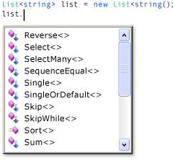
Query vs Method syntax
Query Syntax – simpler, but not always possible (e.g. get item with max value)
IEnumerable<int> numQuery =
from num in numbers
where (num % 2) == 0
select num;
Method Syntax – translated to at compile-time .uses predicates
IEnumerable<int> numQuery2 = numbers.Where(num => num % 2 == 0);
Extension methods
  Extend an existing type
IEnumerable<T>.where
Lambda expressions
  The lambda operator => means
  input goes to output
  Powerful – can be concatenated

Slide 18
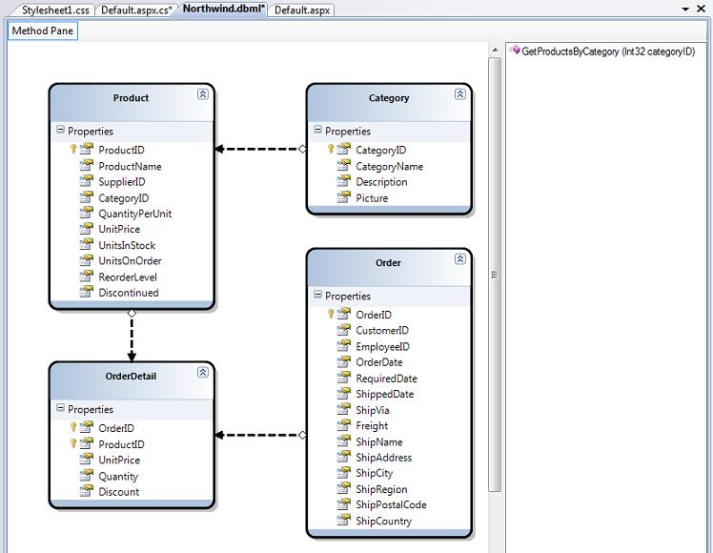
IDE Support
O/R Designer
SqlMetal CLU
Intellisense &
debugger support

Slide 19
LINQ Operators
First, reference tables via DataContext:
Table<Customer> Customers = db.GetTable<Customer>();
Table<Product> Products = db.GetTable<Product>();
Table<Order> Orders = db.GetTable<Order>();

Slide 20
Where
filters a sequence based on a predicate
IEnumerable<Product> expensiveProducts = Products.Where(p => p.UnitPrice >= 10);
IEnumerable<string> productNames = Products.Select(p => p.ProductName);

Slide 21
SelectMany
performs a one to many element projection over a sequence
eg creates a sequence of the orders of the customers in Denmark:
IEnumerable<Order> orders = Customers.Where(c => c.Country == "Denmark").SelectMany(c => c.Orders);
If the query had used Select instead of SelectMany, the result would have been of type IEnumerable<List<Order>> instead of IEnumerable<Order>.

Slide 22
Take
yields X elements from a sequence , then skips remainder of the sequence
IEnumerable<Product> MostExpensive10 =
Products.
OrderByDescending(p => p.UnitPrice).
Take(10);

Slide 23
Skip
skips X elements from a sequence , then yields the remainder of the sequence
IEnumerable<Product> AllButMostExpensive10 =
Products.
OrderByDescending(p => p.UnitPrice).
Skip(10);

Slide 24
Concat
concatenates two sequences
IEnumerable<string> locations = Customers.
Select(c => c.City).
Concat(Customers.Select(c => c.Region)).
Concat(Customers.Select(c => c.Country)).
Distinct();

Slide 25
Sorting
OrderBy or OrderByDescending establishes the primary ordering, the first ThenBy or ThenByDescending establishes the secondary ordering, the second ThenBy or ThenByDescending establishes the tertiary ordering, and so on
IEnumerable<Product> orderedProducts1 =
Products.
OrderBy(p => p.Category).
ThenByDescending(p => p.UnitPrice).
ThenBy(p => p.ProductName);
Reverse

Slide 26
Return type operators
ToSequence - returns its argument typed as IEnumerable<T> - used to choose between query operator implementations in cases where a collection implements IEnumerable<T> but also has a different set of public query operators
ToArray - creates an array from a sequence
ToList - creates a List<T> from a sequence
Both ToArray and ToList force immediate query evaluation, as do the standard query operators that return singleton values (e.g., First, ElementAt, Sum, Average, All, Any).
ToDictionary - creates a Dictionary<K,E> from a sequence.

Slide 27
Dictionary<int, Order> ordersDictionary =
Customers.
SelectMany(c => c.Orders).
Where(o => ((DateTime)o.OrderDate).Year == 2005).
ToDictionary(o => o.OrderID);
string[] customerCountries =
Customers.Select(c => c.Country).Distinct().ToArray();

Slide 28
Other Operators
Distinct - eliminates duplicate elements from a sequence
Union - produces the set union of two sequences
Intersect - produces the set intersection of two sequences
Except - produces the set difference between two sequences
OfType - filters the elements of a sequence based on a type

Slide 29
Specific items
First - returns the first element of a sequence
ElementAt - returns the element at a given index in a sequence
Customer Cust = Customers.First(c => Convert.ToInt32(c.CustomerID) > i);
Product thirdMostExpensive = Products.OrderByDescending(p => p.UnitPrice).ElementAt(2);

Slide 30
Numeric Operators
Count
Min, Max
Sum
Average

Slide 31
Boolean evaluations
Any – checks whether any element of a sequence satisfies a condition
All - checks whether all elements of a sequence satisfy a condition
bool b = Products.Any(p => p.UnitPrice >= 100 && p.UnitsInStock == 0);
Useful for biz logic

Slide 32
Aggregate Operator
applies a function over a sequence
Useful for algorithms

Slide 33
LINQ to Objects
Query non-generic collections
Query a string
Query reflection
Query the file system

Slide 34
Query a string
string aString = "ABCDE99F-J74-12-89A";
// Create the query.
IEnumerable<char> query =
from ch in aString
where Char.IsDigit(ch) //is a decimal char
select ch;
foreach (char c in query)
Console.Write(c + " ");
// Call the Count Standard Query Operator method on the query.
int count = query.Count();

Slide 35
Query Reflection
Can query any collection
string file = @"C:\Program Files\Reference Assemblies\Microsoft\Framework\v3.5\System.Core.dll";
Assembly assembly = Assembly.LoadFrom(file);
var query = from type in assembly.GetTypes()
where type.IsPublic
from method in type.GetMethods()
where method.ReturnType.IsArray == true
|| (method.ReturnType.GetInterface(typeof(System.Collections.Generic.IEnumerable<>).FullName) != null
&& method.ReturnType.FullName != "System.String")
group method.ToString() by type.ToString();

Slide 36
LINQ to SQL
Supports CRUD, SPs, UDFs, Views, Transactions
Integrate validation & biz logic via partial methods
OR Designer – automatically picks up PK/FK 1-1 & 1-M relations
DataContext class – the new DAL
SubmitChanges() - transactional

Slide 37
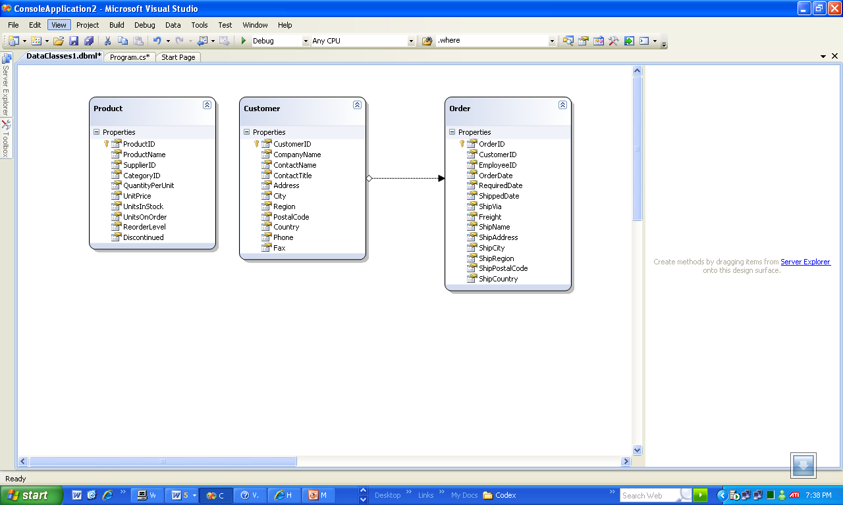

Slide 38
Demo – LINQ to SQL

Slide 39
Insert
Category oCategory = new Category();
oCategory.CategoryName = "xxx";
Product oProduct1 = new Product();
oProduct1.ProductName = "yyy";
Product oProduct2 = new Product();
oProduct2.ProductName = "zzz";
oCategory.Products.Add(oProduct1);
oCategory.Products.Add(oProduct2);
db.Categories.Add(oCategory);
db.SubmitChanges();

Slide 40
Update
Product oProduct3 = db.Products.Single (p => p.ProductName.Equals("xxx"));
oProduct3.UnitPrice = 5;
db.SubmitChanges();

Slide 41
Delete
var oProducts =
from oProduct in db.Products
where oProduct.ProductName.Contains("xxx")
select oProduct;
db.Products.RemoveAll(oProducts);
db.SubmitChanges();

Slide 42
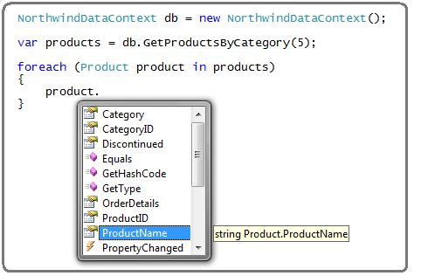
Call a SP

Slide 43
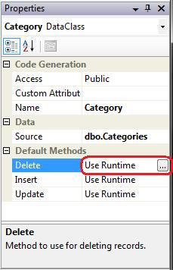
Using SPs for changes

Slide 44
SP mapping
mapped to the DataContext:
var oProducts = oDataContext.GetProductsByCategory(i);
mapped to a data model class:
List<Product> oProducts = oDataContext.GetProductsByCategory(i).ToList();
foreach (Product oProduct in oProducts)
{
oProduct.UnitPrice *= (Decimal) .9;
}
oDataContext.SubmitChanges();

Slide 45
Retrieve with Server Side Paging
var oProducts =
(
from oProduct in oDataContext.Products
where oProduct.Category.Name.StartsWith( “x”)
select oProduct
).Skip(200).Take(10);

Slide 46
Performance Comparison

Slide 47
Look at the old way
SqlCommand cmd = con.CreateCommand();
string cmdText = "select OrderID, CustomerID, EmployeeID, ShippedDate from Orders";
cmd.CommandText = cmdText;
SqlDataReader dr = cmd.ExecuteReader();
while (dr.Read())
{
OrderDetail o = new OrderDetail();
o.OrderID = dr.GetInt32(0);
o.CustomerID = dr.GetString(1);
if (!dr.IsDBNull(2)) o.EmployeeID = dr.GetInt32(2);
else o.EmployeeID = null;
if (!dr.IsDBNull(3)) o.ShippedDate = dr.GetDateTime(3);
else o.ShippedDate = null;
sum += o.OrderID;
count++;
}

Slide 48
CompiledQuery
var fq = CompiledQuery.Compile(
(Northwinds nw) =>
from o in nw.Orders
select new OrderDetail
{
OrderID = o.OrderID,
CustomerID = o.CustomerID,
EmployeeID = o.EmployeeID,
ShippedDate = o.ShippedDate
}
);
foreach (var detail in fq(nw))
{
sum += detail.OrderID;
count++;
}

Slide 49
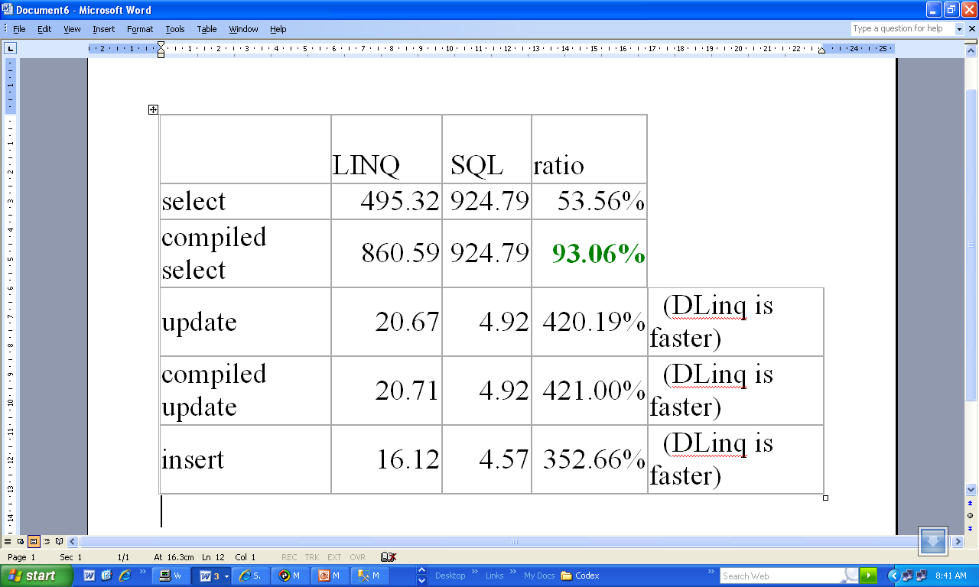
Performance results – Queries/Sec

Slide 50
Entity Classes
Map to tables. Have [Table] class attribute
Create via drag & drop
Adv over typed datasets: don’t have to specify queries when creating
Can inherit from base classes, supports partial classes
Naming & Pluralization

Slide 51
DataClass generated code
The DataContext:
[System.Data.Linq.Mapping.DatabaseAttribute(Name="Northwind")]
public partial class DataClasses1DataContext : System.Data.Linq.DataContext
{
…
}
Some partial methods:
partial void InsertCustomer(Customer instance);
partial void UpdateCustomer(Customer instance);
partial void DeleteCustomer(Customer instance);

Slide 52
A Table
[Table(Name="dbo.Customers")]
public partial class Customer : INotifyPropertyChanging, INotifyPropertyChanged
{
private static PropertyChangingEventArgs emptyChangingEventArgs = new PropertyChangingEventArgs(String.Empty);
private string _CustomerID;
private string _CompanyName;
…
private EntitySet<Order> _Orders;

Slide 53
A Column
[Column(Storage="_CustomerID", DbType="NChar(5) NOT NULL", CanBeNull=false, IsPrimaryKey=true)]
public string CustomerID
{
get
{
return this._CustomerID;
}
set
{
if ((this._CustomerID != value))
{
this.OnCustomerIDChanging(value);
this.SendPropertyChanging();
this._CustomerID = value;
this.SendPropertyChanged("CustomerID");
this.OnCustomerIDChanged();
}
}
}

Slide 54
An Association
[Association(Name="Customer_Order", Storage="_Orders", OtherKey="CustomerID")]
public EntitySet<Order> Orders
{
get
{
return this._Orders;
}
set
{
this._Orders.Assign(value);
}
}

Slide 55
Property Change Notification
INotifyPropertyChanging, INotifyPropertyChanged – notify client on property value change
private static PropertyChangingEventArgs emptyChangingEventArgs = new PropertyChangingEventArgs(String.Empty);
public event PropertyChangingEventHandler PropertyChanging;
public event PropertyChangedEventHandler PropertyChanged;
protected virtual void SendPropertyChanging()
{
if ((this.PropertyChanging != null))
{
this.PropertyChanging(this, emptyChangingEventArgs);
}
}

Slide 56
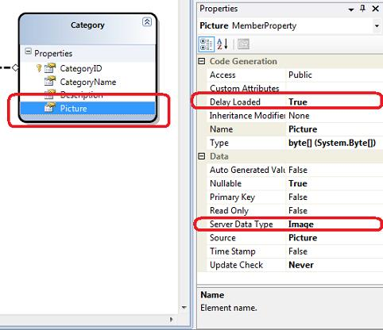
Lazy loading
specify whether the properties on entities should be prefetched or fetched only on use
Delay Loaded property

Slide 57

Debugger support
See generated SQL

Slide 58
ASP.NET databinding
Includes paging & sorting support
void BindProducts (int iRowStart)
{
oGridView.DataSource = oProducts.
Skip(iRowStart).Take(10);
oGridView.DataBind();
}

Slide 59
Validation
Good place to centralize validation
Auto schema validation – compile time type checking, run time null & identity checking
Partial validation methods:
using System.Text.RegularExpressions;
public partial class Customer
{
//partial method:
partial void OnPhoneChanging (string sValue)
{
Regex oRegex = new Regex (@”^[2-9]\d{2}-\d{3}-\d{4}$”);
if (!oRegex.IsMatch(sValue)) throw new Exception (“invalid phone number”);
}
}
Validate() partial method - To validate multiple properties for an entity class

Slide 60
<asp:LinqDataSource> control
Declarative binding support
<asp:GridView id=”oGridView” runat=”server”
DataSourceID=”oLinqDataSource”
AllowPaging=”true”
AllowSorting=”true”
/>
<asp:LinqDataSource” id=oLinqDataSource” runat=”server”
ContextTypeName=”MyNS.oDataContext”
TableName=”Products”
EnableUpdate=”true”
EnableDelete=”true”
/>

Slide 61
Custom SQL Expressions
DataContext.ExecuteQuery partial method
public partial class NorthwindDataContext
{
  public IEnumerable<Product> GetProductsByCategory (int iCategoryId)
  {
  return ExecuteQuery<Product> (@”SELECT * FROM PRODUCTS WHERE CategoryID={0} ”, iCategoryId);
  }
}

Slide 62
Change Tracking
DataContext.SubmitChanges(), RejectChanges()
Transactional , optimistic concurrency
while (iRetries < 5)
{
// fetch objects and make changes here
try
{
db.SubmitChanges();
break;
}
catch (ChangeConflictException e)
{
iRetries++;
}
}

Slide 63
Database creation
MyDVDs db = new MyDVDs("c:\\mydvds.mdf");
if (db.DatabaseExists()) {
Console.WriteLine("Deleting old database...");
db.DeleteDatabase();
}
db.CreateDatabase();

Slide 64
Inheritance
Support for single table mapping
    [InheritanceMapping] class attribute - for each class in the hierarchy structure. Specify Code property & Type property
    IsDiscriminator property for a [Column] attribute, - indicate the column that holds the Code value for inheritance mapping.
    IsDefault property - "fallback" mapping in case the discriminator value does not match any of the Code values.

Slide 65
[Table]
[InheritanceMapping(Code = "C", Type = typeof(Car))]
[InheritanceMapping(Code = "T", Type = typeof(Truck))]
[InheritanceMapping(Code = "V", Type = typeof(Vehicle),
IsDefault = true)]
public class Vehicle
{
[Column(IsDiscriminator = true)]
public string DiscKey;
[Column(IsPrimaryKey = true)]
public string VIN;
[Column]
public string MfgPlant;
}
public class Car : Vehicle
{
[Column]
public int TrimCode;
[Column]
public string ModelName;
}

Slide 66
var q = db.Vehicle.Where(p => p is Truck);
//or
var q = db.Vehicle.OfType<Truck>();
//I LIKE THIS ONE!
//or
var q = db.Vehicle.Select(p => p as Truck).Where(p => p != null);
foreach (Truck p in q)
Console.WriteLine(p.Axles);

Slide 67
Local Queries
Customer oCustomer = db.Customers.Single(x => x.CustomerID.Equals(1));
foreach (Order ord in oCustomer.Orders.Where(o => o.ShippedDate.Value.Year == 1998))
{
//executed on server
}
oCustomer.Orders.Load();
foreach (Order ord in oCustomer.Orders.Where(o => o.ShippedDate.Value.Year == 1998))
{
//executed on client
}

Slide 68
Optimistic Concurrency
try
{
db.SubmitChanges(ConflictMode.ContinueOnConflict);
break;
}
catch (ChangeConflictException)
{
iRetries++;
foreach (ObjectChangeConflict OCC in db.ChangeConflicts)
{
// investigate further
}
}

Slide 69
Generated SQL
TextWriter DataContext.Log - Prints SQL before it is executed
DataContext.GetChangeSet().ModifiedEntities

Slide 70
Demo – LINQ to SQL WinForm

Slide 71
LINQ to XML
in-memory XML API - provides both DOM and XQuery/XPath like functionality
Clean, fast, easy, consistent
Implemented over XmlReader - fast
3 main types: XName, XElement and XAttribute

Slide 72
System.Xml.Linq.XElement
let – introduce an identifier
// Create the query.
var query = new XElement("Root",
from student in students
let x = String.Format("{0},{1},{2},{3}", student.Scores[0],
student.Scores[1], student.Scores[2], student.Scores[3])
select new XElement("student",
new XElement("First", student.First),
new XElement("Last", student.Last),
new XElement("Scores", x)
) // end "student"
); // end "Root"
// Execute the query.
Console.WriteLine(query);

Slide 73
C#
private static void XElementDataSource(ref XElement contacts)
{
contacts =
new XElement("Contacts",
new XElement("Contact",
new XElement("Name", "Patrick Hines"),
new XElement("Phone", "206-555-0144",
new XAttribute("Type", "Home")),
new XElement("phone", "425-555-0145",
new XAttribute("Type", "Work")),
new XElement("Address",
new XElement("Street1", "123 Main St"),
new XElement("City", "Mercer Island"),
new XElement("State", "WA"),
new XElement("Postal", "68042")
)
)
);
}

Slide 74
VB.NET
construct the XML tree is even simpler - XML literals are translated by compiler into method calls
Dim contacts =
<Contacts>
<Contact>
<Name>Patrick Hines</Name>
<Phone Type="Home">206-555-0144</Phone>
<Phone Type="Work">425-555-0145</Phone>
<Address>
<Street1>123 Main St</Street1>
<City>Mercer Island</City>
<State>WA</State>
<Postal>68042</Postal>
</Address>
</Contact>
</Contacts>

Slide 75
Advantages
Tree construction indents show structure
Focus on element trees instead of documents
Support for fragments, white space (as XText nodes) , XPath, XSD

Slide 76
Transforming into XML
class Student
{
public string First { get; set; }
public string Last { get; set; }
public int ID { get; set; }
public List<int> Scores;
}
// Create the data source.
List<Student> students = new List<Student>()
{
new Student {First="Svetlana", Last="Omelchenko", ID=111, Scores = new List<int>{97, 92, 81, 60}},
new Student {First="Claire", Last="O’Donnell", ID=112, Scores = new List<int>{75, 84, 91, 39}},
new Student {First="Sven", Last="Mortensen", ID=113, Scores = new List<int>{88, 94, 65, 91}},
};
- <Root>
- <student>
<First>Svetlana</First>
<Last>Omelchenko</Last>
<Scores>97,92,81,60</Scores>
</student>
- <student>
<First>Claire</First>
<Last>O'Donnell</Last>
<Scores>75,84,91,39</Scores>
</student>
- <student>
<First>Sven</First>
<Last>Mortensen</Last>
<Scores>88,94,65,91</Scores>
</student>
</Root>

Slide 77
XML Tree from Query
XElement srcTree = new XElement
(
"Root",
new XElement("Element1", 1),
new XElement("Element2", 2),
new XElement("Element3", 3),
new XElement("Element4", 4),
new XElement("Element5", 5)
);
XElement xmlTree = new XElement("Root",
new XElement("Child1", 1),
new XElement("Child2", 2),
from el in srcTree.Elements()
where (int)el > 2
select el
);
Console.WriteLine(xmlTree);

Slide 78
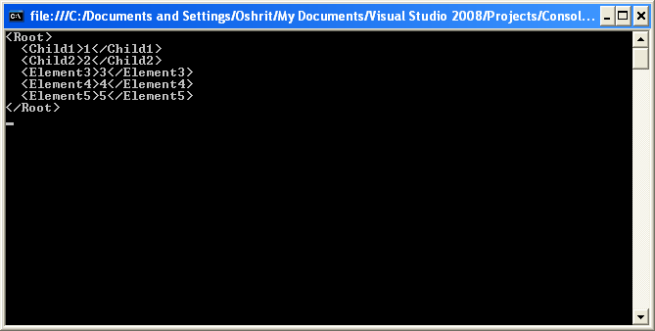

Slide 79
Create an XDocument
XDocument d = new XDocument
(
new XProcessingInstruction("xml-stylesheet",
"href='mystyle.css' title='Compact' type='text/css'"),
new XElement("Pubs",
new XElement("Book",
new XElement("Title", "Artifacts of Roman Civilization"),
new XElement("Author", "Moreno, Jordao")
),
new XElement("Book",
new XElement("Title", "Midieval Tools and Implements"),
new XElement("Author", "Gazit, Inbar")
)
),
new XComment("This is a comment.")
);
d.Declaration = new XDeclaration("1.0", "utf-8", "true");
d.Save("test.xml");

Slide 80
Load from file
XElement booksFromFile = null;
try
{
booksFromFile = XElement.Load(@"books.xml");
}
catch (System.Xml.XmlException e)
{
Console.WriteLine(e);
}

Slide 81
Parsing an XML String
XElement contacts = XElement.Parse(
@"<Contacts>
<Contact>
<Name>Patrick Hines</Name>
<Phone Type=""home"">206-555-0144</Phone>
<Phone type=""work"">425-555-0145</Phone>
<Address>
<Street1>123 Main St</Street1>
<City>Mercer Island</City>
<State>WA</State>
<Postal>68042</Postal>
</Address>
<NetWorth>10</NetWorth>
</Contact>
</Contacts>");

Slide 82
Querying XML Trees
XElement root = XElement.Load("PurchaseOrder.xml");
IEnumerable<XElement> address =
from el in root.Elements("Address")
where (string)el.Attribute("Type") == "Billing"
select el;
foreach (XElement el in address)
Console.WriteLine(el);
The equivalent XPath:
/PurchaseOrder/Address[@Type='Billing']

Slide 83
Modifying XML Trees
XElement root2 = XElement.Load("Data.xml");
foreach (XAttribute att in root.Attributes())
{
root2.Add(new XElement(att.Name, (string)att));
}
root2.Attributes().Remove();
The functional approach – construct a new XML tree:
XElement newTree = new XElement
(
"Root",
root.Element("Child1"),
from att in root.Attributes()
select new XElement(att.Name, (string)att)
);

Slide 84
Demo – LINQ to XML

Slide 85
WCF and Attach

Slide 86
Other features
PLINQ
BLINQ
LINQ to RDF
LINQ to Excel
Attach support, M-M support
Entity Framework & LINQ to Entities
Domain Driven Design

Slide 87
Further Information
http://oakleafblog.blogspot.com
http://forums.microsoft.com/MSDN/ShowForum.aspx?ForumID=123&SiteID=1
http://linqinaction.net/blogs/default.aspx

